Slide 1
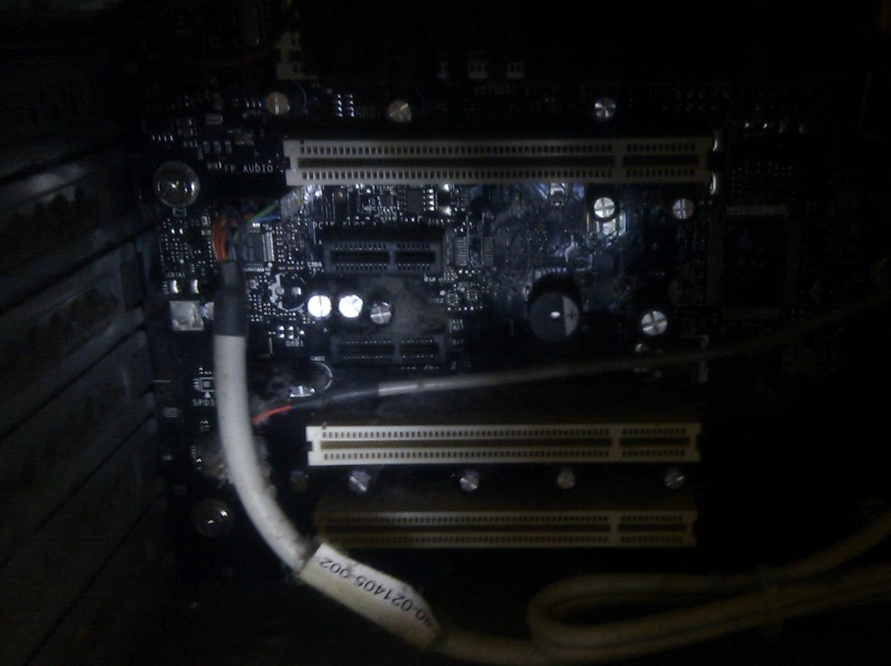

Computing Systems
Lecture 10
Inside the CPU

Slide 2
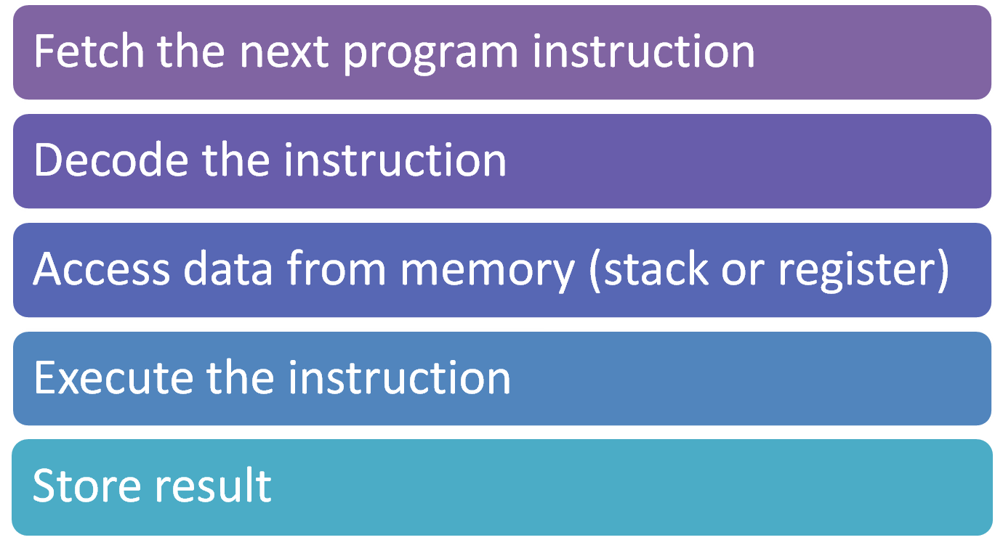
The Instruction Cycle

Slide 3
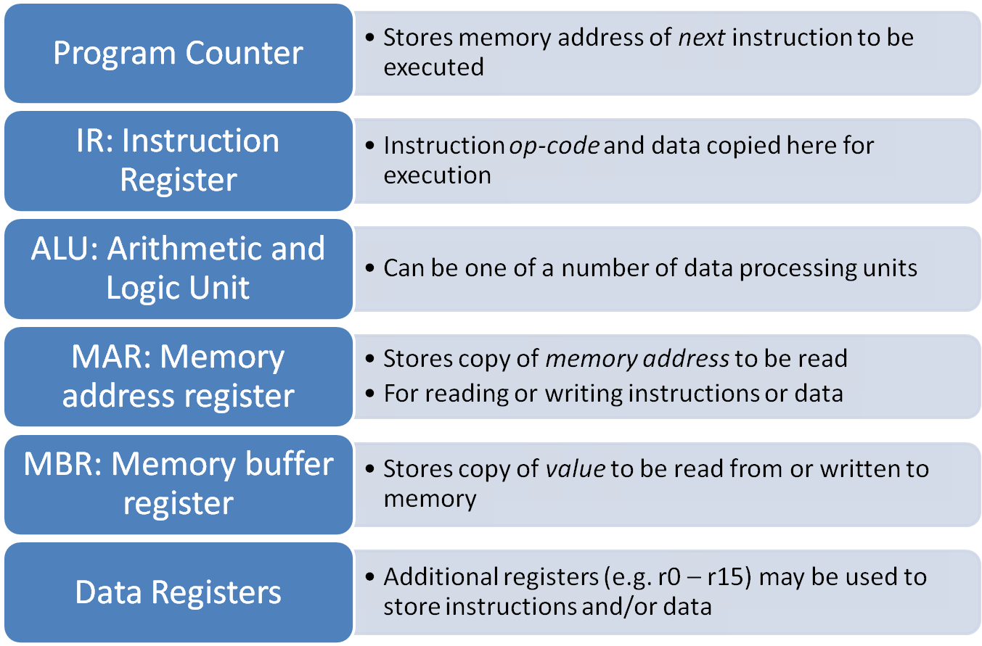
Elements of a CPU

Slide 4
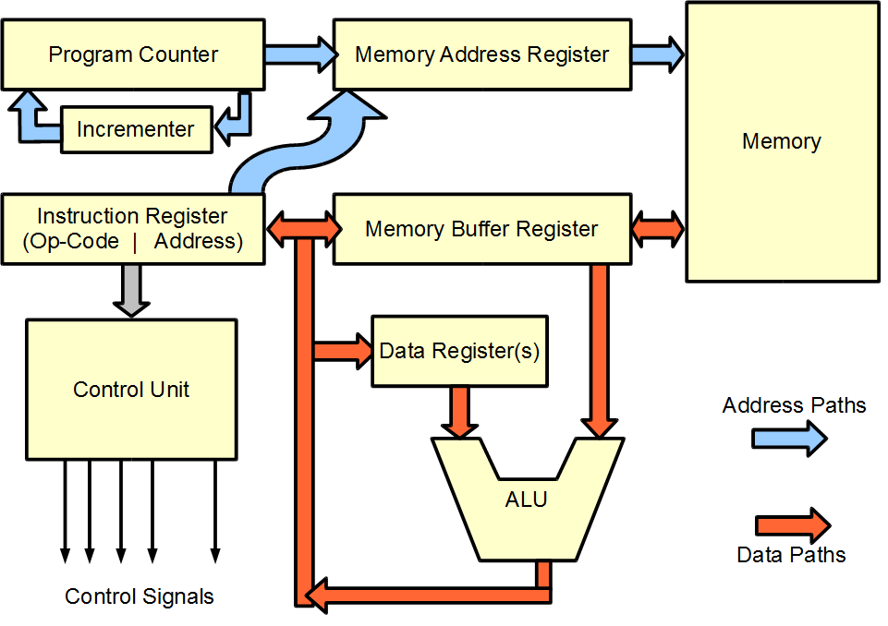
Notes:
This diagram is based on Alan Clement’s schematics from http://www.alanclements.co.uk/Resources/CPU_FE/FetchExecute.htm (now a dead link)

Slide 5
Alternative Architectures
Modern computer architectures typically provide a number of processor registers
  Most computation is on values in registers
  Additional work moving values into and out of registers
General Purpose Registers and Cache vs Seperate Instruction & Data Registers & Cache
Registers vs Stack
Notes:
Machines like the PS2 provided separate 16k buffers for data and instructions on the processor chip. These provided fast access to instructions and data for processor intensive loops

Slide 6
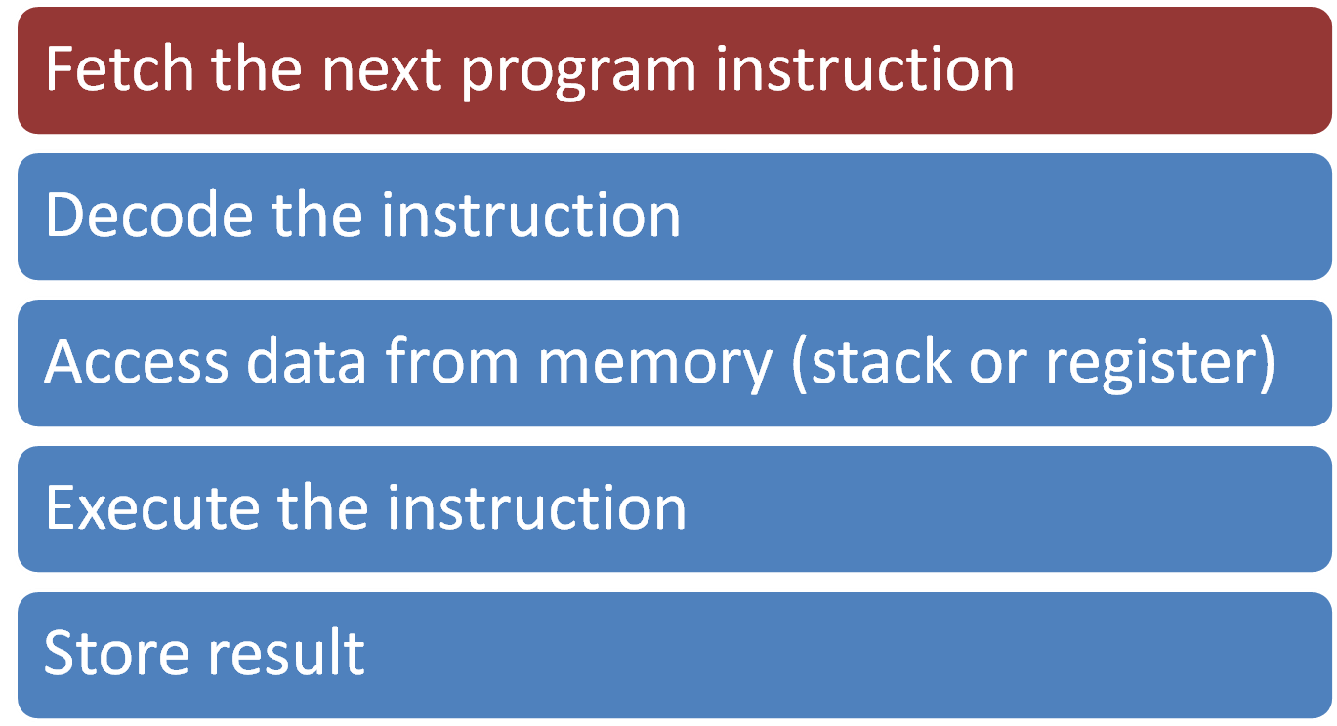
The Instruction Cycle

Slide 7
Fetch Instruction
[ MAR ] ← [ PC ]
[ PC ] ← [ PC ] + 4
[ MBR ] ← [ [ MAR ] ]
[ IR ] ← [ MBR ]
Example using Register Transfer Language
Lines 1 & 2: Place copy of PC into MAR, then increment PC to point to next instruction (+4 bytes or +1 32-bit word)
Line 3: Copy instruction from memory address pointed to by MAR into MBR
Line 4: Copy instruction from MBR to IR
Notes:
This example is given using Register Transfer Language (RTL) – see http://www.alanclements.co.uk/Resources/CPU_FE/FetchExecute.htm , Principles of Computer Hardware Chapter 6 (4th Edition)

Slide 8
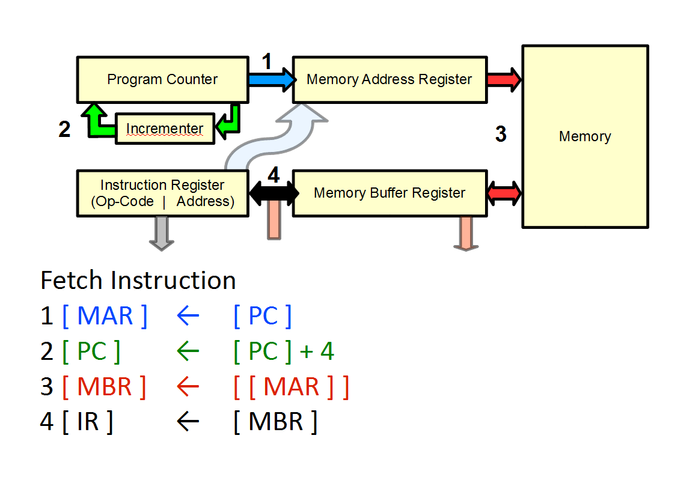
Notes:
This diagram is based on Alan Clement’s schematics from http://www.alanclements.co.uk/Resources/CPU_FE/FetchExecute.htm (now a dead link)

Slide 9
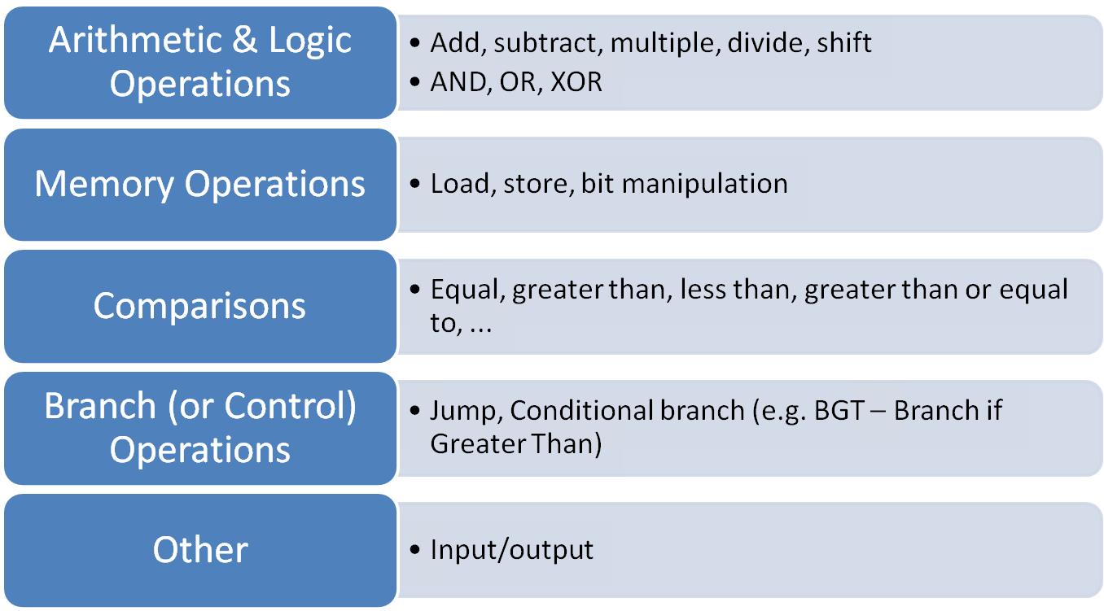
Instruction Types

Slide 10
Registers
CPU will have a number of ‘registers’ for storing data – the inputs and outputs from individual instructions
  Small in number, e.g. 16 on basic ARM processors
Need to move data from memory to registers for when used
  Data frequently needs to be moved into/out of registers
  About 30%-40% of machine code instructions in a modern program may be load/store instructions
Notes:
1970’s analysis was that about 45% of instructions were load/store – see PCH p328-329

Slide 11
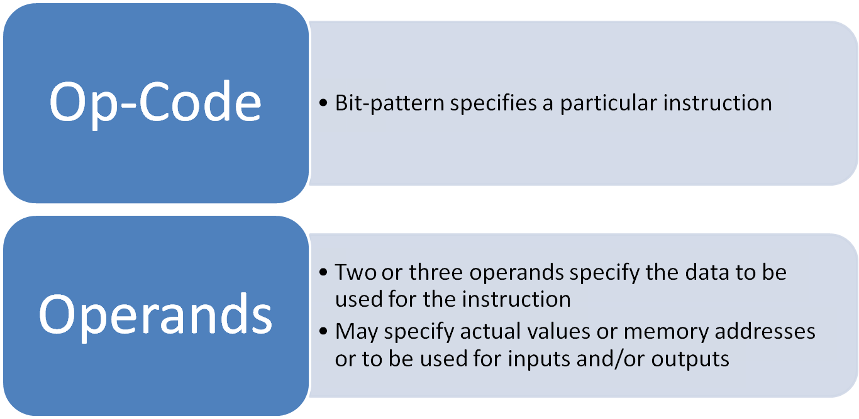
Decode Instruction
Instruction register stores a complete instruction consisting of:

Slide 12
Instruction Examples
ADD r1, r3, r2 ; add r3 and r2, store result in r1
ADD r1, r3, #2 ; add 2 to r3, store result in r1
MOV r3, #5 ; store value 5 in r3
MUL r5, r2, r1 ; Multiply r2 by r1, store in r5
CMP r0, r1 ; Compare r0 and r1
BEQ label ; Branch (jump) to labelled position
in program if compared values were
equal
Notes:
r1, r2, etc are the registers

Slide 13
Instruction Sets
Instruction sets vary by processor
  Processors in one ‘family’ will share a common core instruction set
Some instruction sets allow single instructions to perform quite complex operations
  E.g. Operate on values from different memory addresses and store result in another memory address
  CISC – Complex Instruction Set Computing

Slide 14
Limits of CISC
Move towards CISC resulted in processors adding increasingly complex commands
  Trying to match functions of high-level languages
Expensive circuitry for some rarely used commands
Decode circuitry complexity affects performance
Single instruction might take several (many) clock cycles to complete

Slide 15
CISC and Microcode
During 1970’s memory hardware and architectures were particularly slow relative to speed of processor
A single instruction which resulted in a sequence of complex processor operations would require less memory access
Complex Instruction Sets which resulted in single instructions being broken down into multiple microcode instructions in the processor improved system performance
Notes:
The key point of this is simply to reinforce the notion that a single assembly language/machine code instruction can translate into many different operations that need to be carried out on the processor. A detailed discussion of microcode is not required!
The improved system performance referred to in the last point is an overall improvement due to a decreased need to fetch instructions from main memory.

Slide 16
Reduced Need for Microcode
Faster RAM and addition of on-chip cache memory (small amounts of RAM that operate at, or near to, the speed of the processor) reduced need for complex instructions
Cost of additional, possibly rarely used, circuitry for CISC provided reduced benefits
Eliminating more complex instructions allows processors to complete an instruction every clock cycle
Notes:
Essential point here is that micro-code no longer provides the scale of benefit it once did: most instruction fetches are from L1 or L2 cache, which is not as slow as a fetch from main memory. Benefit of micro-code now offset by the additional complexity of such systems and by the extra processor cycles required to complete a single complex instruction

Slide 17
Reduced Instruction Set Computing
Limit processor to more basic operations
Simpler decode circuitry allows for higher processor speeds
  Fixed time to execute any instruction
CISC-type operations might require multiple RISC operations
Compiler takes on more responsibility for optimisation
  Relegate Important Stuff to Compiler

Slide 18


Cycles Per Instruction
If result of one operation needs stored before the next operation can begin...
  About 5 clock cycles per RISC instruction:
  Instruction Fetch, Instruction Decode, Execute, Memory access, Write Back
    Some instructions may take two cycles to operate – MEM represents this. Single cycle instructions would simply pass result forward, so that all instructions now take two cycles
    Some RISC architectures only use single cycle instructions

Slide 19
Pipelined Architectures
Most of the time, the next instruction to be executed will be the next instruction in the program (increment PC)
Fetching next instruction while still processing previous will speed up execution
  Lose benefit in event of branch
  Branch prediction can try to solve this

Slide 20




Pipelined Execution
Potentially complete an instruction every clock cycle
As first instruction completes, the sixth instruction enters the pipeline

Slide 21
RISC vs CISC
Over time CISC evolved to embrace some of the features originally developed as part of RISC designs
  E.g. Pipelining support on x86 architectures
CISC (x86 derived) continues to dominate PCs
  Compatibility with existing user base
RISC dominates mobile, embedded & entertainment
  ARM (mobile), PowerPC (Xbox 360, PS3, Wii)

Slide 22
GPU Architecture
GPUs have to perform the same operation many times over on large sets of data
  E.g. Rotating the 1000s of vertices in a single 3D model – each point being subject to the same set of transformations
SIMD: Single Instruction, Multiple Data
  Use a single instruction to carry out the one operation on many pieces of data

Slide 23
GPU cores
Modern GPUs may have over 1000 GPU cores
  Hundreds/Thousands of operations per cycle!
Cores grouped into units
  One set of cores operating on one set of data, while another set operates on another set
Highly optimised for graphical and some scientific/engineering problems
  Very wasteful/costly for more generic computing problems!
Notes:
Avoiding going into the jargon here – there are two main GPU product lines from AMD and Nvidia, each with their own very specific sets of jargon which makes it challenging to pull out the more general issues and workings

Slide 24
SIMD on CPUs
A range of SIMD instructions also exist on x86 family (and some other) CPUs
These allow SIMD operations on data held in special registers on the CPU
Typically around 8 to 16 registers for SIMD on AMD/Intel CPUs
  Designed for improved video and similar processing
  Compare to 100s of cores on GPUs

Slide 25
Multi-Core CPUs
Modern CPUs are also now increasingly using multi-core designs to allow multiple processes to run simultaneously and boost performance
x86/x64 desktop typically have 2 to 6 cores
ARM mobile processors may have 1 to 4 cores
Cores have to share access to system bus, but each will have own cache and perform own operations

Slide 26
‘APU’
Some chip manufacturers now ship integrated CPU/GPU parts: both CPU and GPU in a single integrated circuit
  AMD refers to these as ‘accelerated processing units’ or APU
Range of processor and GPU architectures available in these configurations
  More compute power for lower electrical power usage
  Lower overall system cost
  Generally not as powerful as discrete CPU + GPU systems
    Where battery life and system cost is more important than raw performance, e.g. Mobile systems

Slide 27
Further Reading
Wikipedia:
  Instruction Cycle, RISC, Instruction Pipeline
PCH
  Chapters 6-9
    Especially chapter 7: Structure of the CPU
ECS

Slide 28
Next Week
20th Century computing: Human stories
Recommended Reads:
  Accidental Empires (out of print, but available 2nd hand online)
  Wikipedia entries on:
  Ada Lovelace, Alan Turing, John von Neumann, Vanevar Bush, Alan Kay (& Xerox PARC), Grace Hopper, Konrad Zuse, Bill Gates, Steve Jobs, Tim Berners-Lee, ...

Slide 29
Image Credits:
Title Image – CC-BY-SA Daniel Livingstone, 2011
The CPU data/address paths schematic was created by Daniel Livingstone, but based on original by Alan Clements at http://www.alanclements.co.uk/Resources/CPU_FE/FetchExecute.htm (site currently down) - versions of this diagram are also published in Principles of Computer Hardware and available in the instructor resources that accompany the book.
Product names, logos, brands, and other trademarks featured or referred to within the these notes are the property of their respective trademark holders. These notes have been produced without affiliation, sponsorship or endorsement from the trademark holders.

